Slide 1



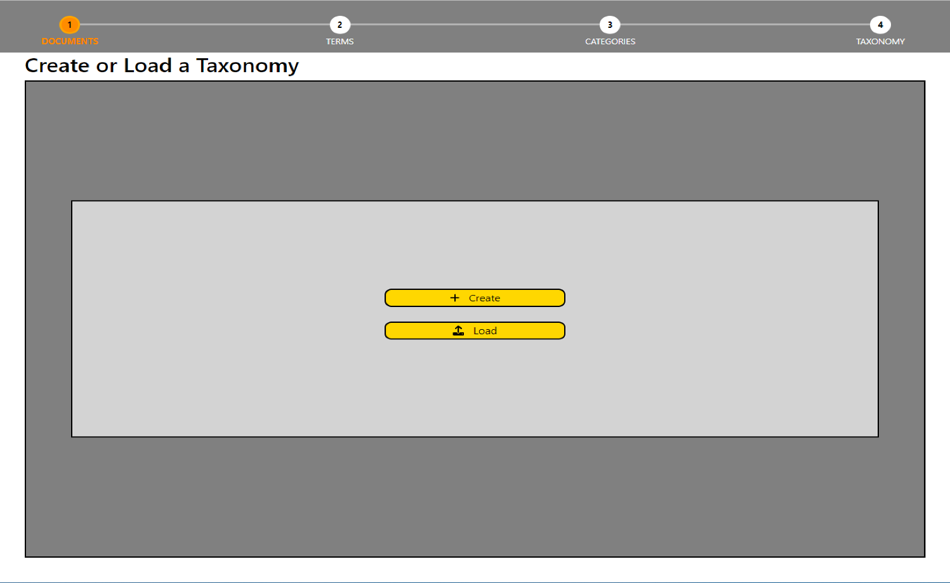
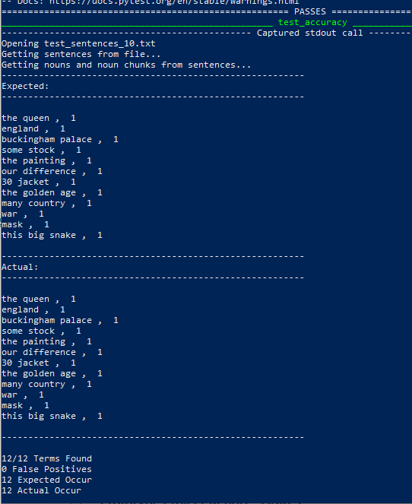
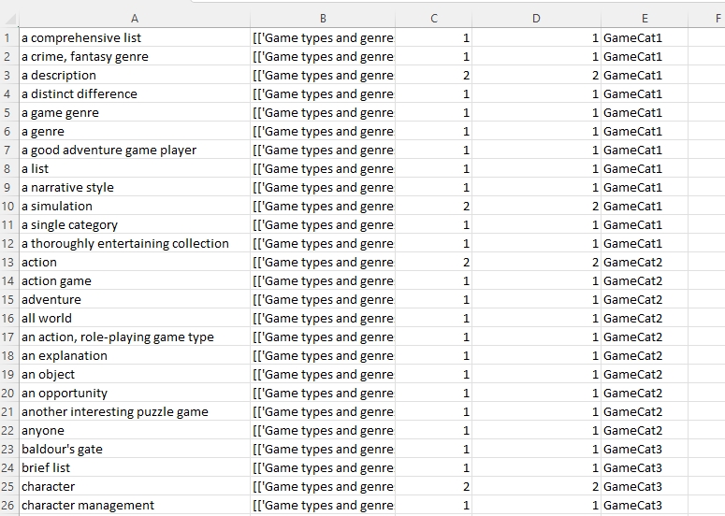
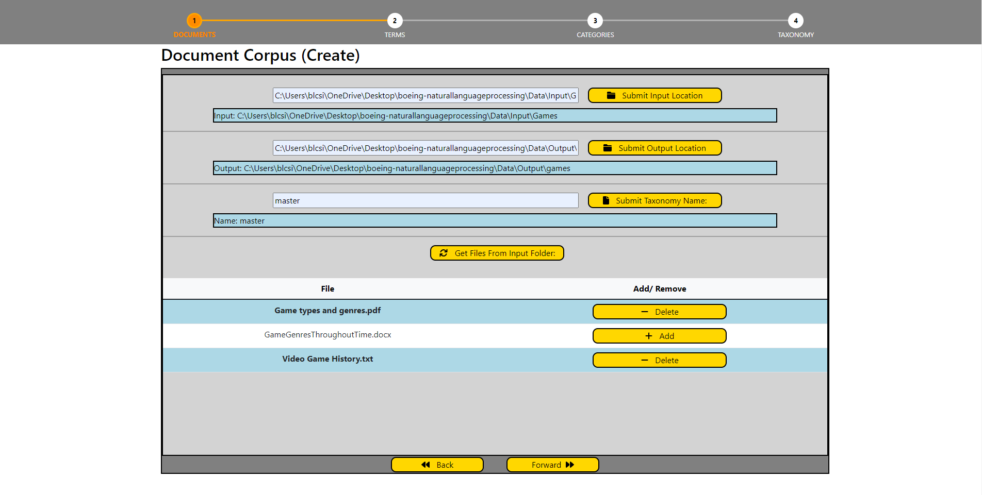

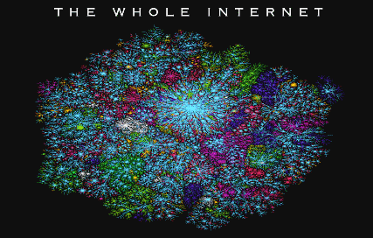
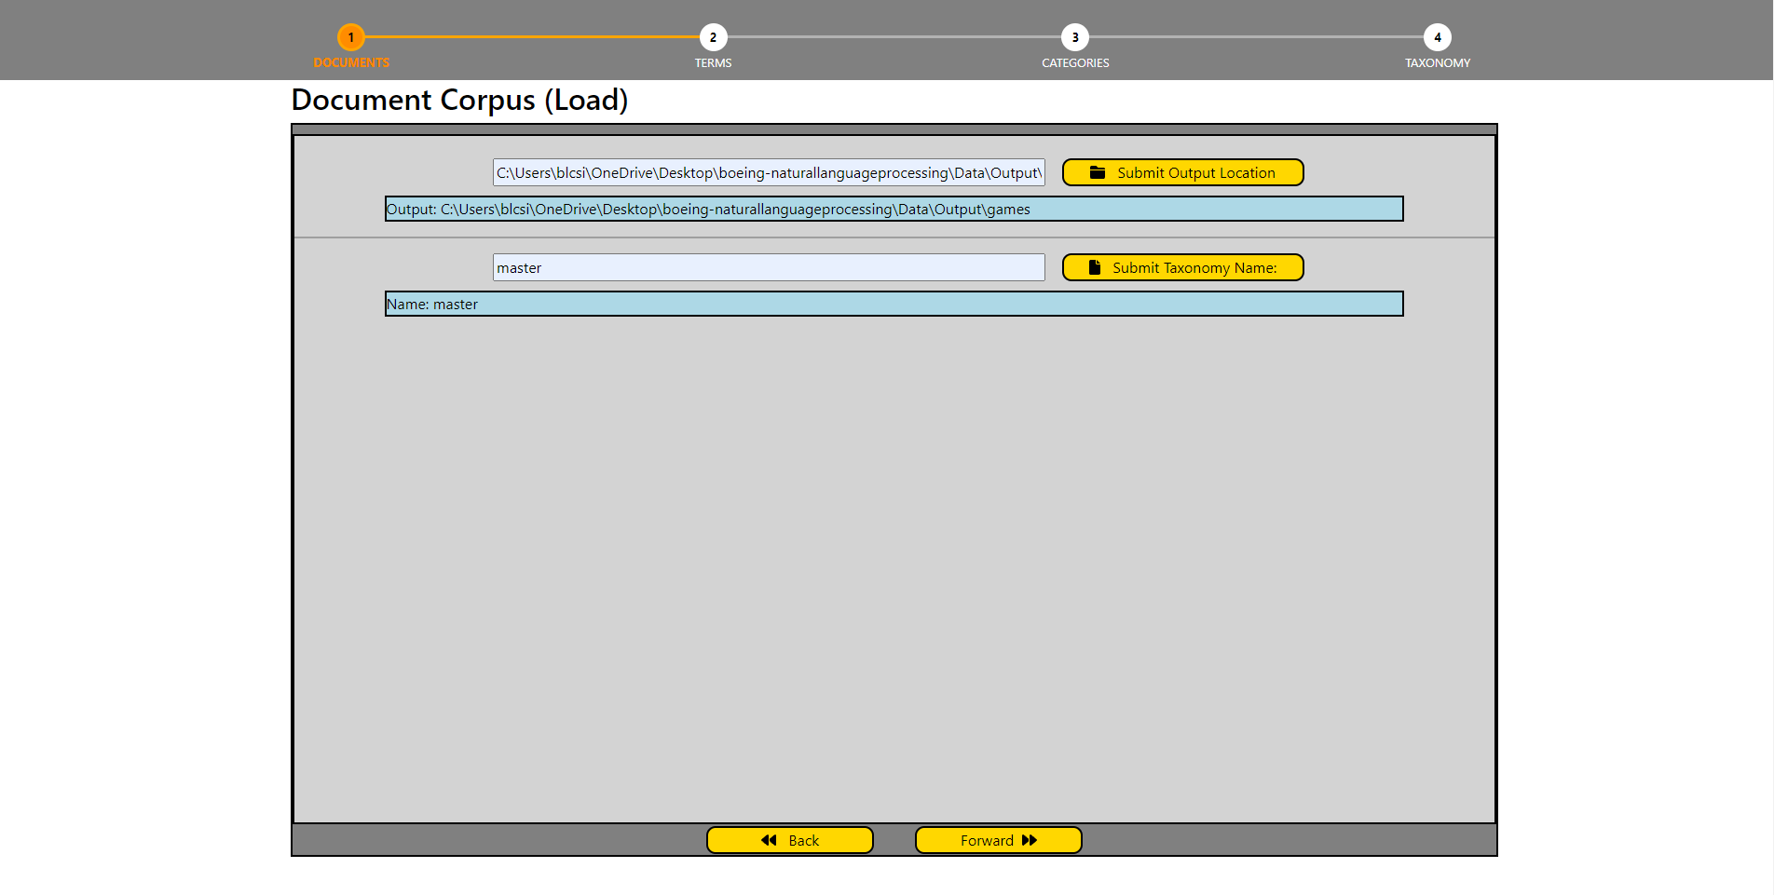






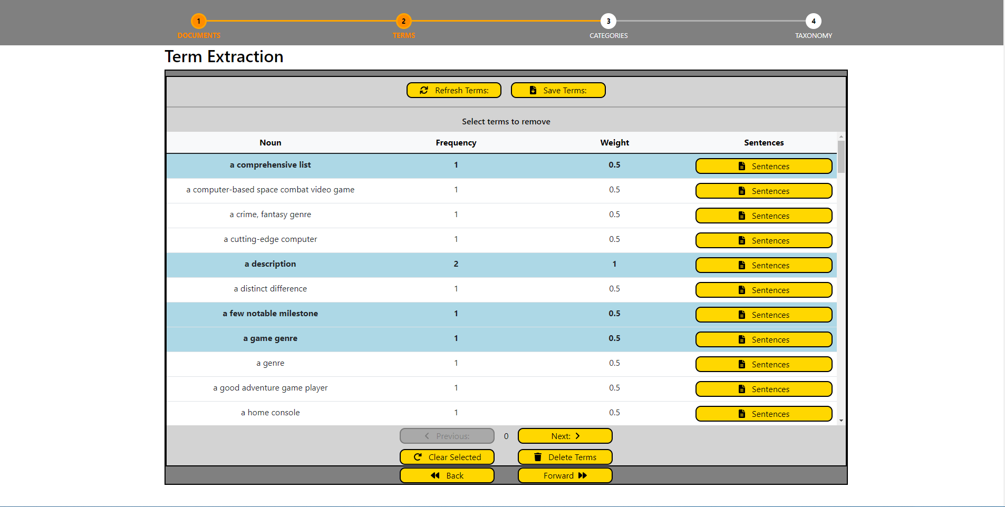





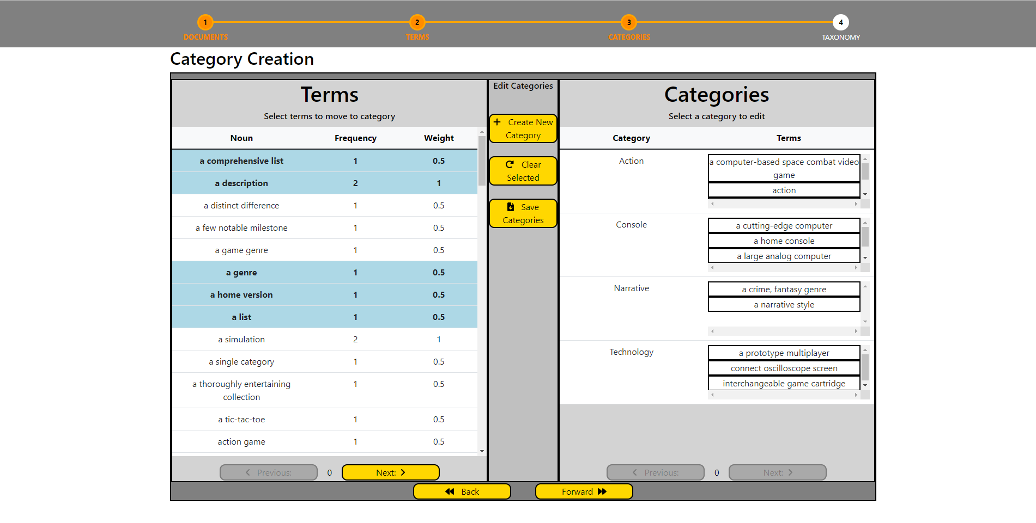

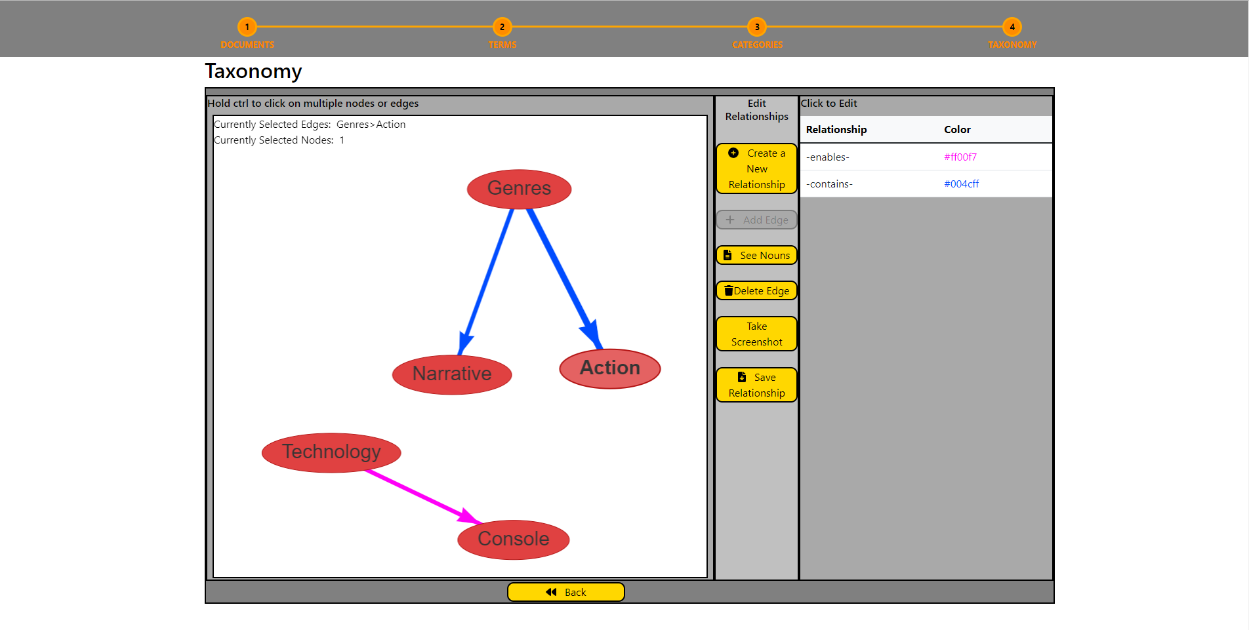
Natural Language Processing & Taxonomy Creation Tool
Sponsor: Boeing Mentors: Don Brancato & Rakshit Bhatt Team: Brandon Christenson, Kadir Nour, & Riley Hunter
Why do we need parsers?
Pipeline
Testing
“The quick brown fox jumps over the lazy dog" is a pangram—a sentence that contains all the letters of the alphabet. The phrase is commonly used for touch-typing practice, testing typewriters and computer keyboards, displaying examples of fonts, and other applications involving text where the use of all letters in the alphabet is desired.
We created unit and integration tests for our back-end modules using the Pytest framework.
ex. Text extraction accuracy, Writing to .csv and .json files, Performance (time), etc.
We created end-to-end tests for our front-end using the TestCafé suite.
ex. Popup modals, Adding or deleting categories, Displaying terms in tables, etc.
We set up an automated CI/CD pipeline using GitHub Actions to verify all code pushed to our main branch.
Step 0: Create or Load
User can create a new taxonomy or load from a saved taxonomy…
“The quick brown fox jumps over the lazy dog" is a pangram—a sentence that contains all the letters of the alphabet. The phrase is commonly used for touch-typing practice, testing typewriters and computer keyboards, displaying examples of fonts, and other applications involving text where the use of all letters in the alphabet is desired.
Step 1: Document Corpus (Create)
User can select input and output locations and choose which documents will be part of the constrained vertical…
Step 1: Document Corpus (Load)
User can select output location and the name of the saved taxonomy..
Tool Used
What is "Blue"?
Step 2: Term Extraction
User can run the parser to find noun and noun-phrases from the constrained vertical. User can then remove unwanted terms from the taxonomy…
Glossary
Knowledge = Context + Data
Natural Language Processing: A branch of computer science concerned with giving computers the ability to understand text and spoken words. Taxonomy: A branch of science concerned with categorization and classification.
Parser: A program that can analyze strings which conform to the rules of a formal grammar.
Constrained Vertical: A group of documents which all belong to the same topic.
Pipeline Architecture: An architectural pattern which consists of a chain of processing elements arranged so that the output of each element is the input for the next.
Knowledge: information that contains data and context.
Corpus: A collection of texts.
Step 3: Category Creation
User can create categories and add terms into them…
Boeing Use Case
John is a test pilot for Boeing. He would like to use the 737-flight manual as a reference, but he does not want to read through the entire 200-page document to find the information he needs.
Running our tool first finds key terms from the document (the vocabulary). He then organizes the vocabulary into categories (as an expert himself, he knows which categories to create). One of the categories he creates is “Take-Off Procedures”, and another is “Take-Off Controls”. He finishes by creating a “uses” relationships between “Take-Off Procedures” and “Take-Off Controls”.
Now, if John wants to find information on take-off procedures, he can search for that category. If he wants to find information on take-off controls, then he would check the related categories and find the “Take-Off Controls” category.
Acknowledgements
Step 4: Taxonomy
User can create relationships between categories and take a screenshot of the graph…
We want to thank our mentors from Boeing, Don and Rocky, for the help and instruction they have given us throughout this project.
We also want to thank our professor AJ for the guidance he has given during our senior year, and for his assistance in preparation for our future careers.
Team Boeing NLP

